Slide 1

NoSQL: Apache Kafka

Slide 2
Why Kafka?

Slide 3





Recall: Polyglot Persistence
In our new world of polyglot persistence, how do we integrate disparate data sources and have them exchange timely data?
E-commerce application
Shopping cart
Product catalog
Web analytics
Recommendations
Notes:
In the new world of microservice architectures where systems are architected to handle single responsibilities in order to address scalability, we have unique data challenges.
READ SLIDE
Mainly around data integration. That is with our data stored in 4 different places, how to we insure that each of these persistent data stores contain the most timely and accurate information?

Slide 4


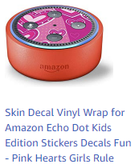
An Abridged Example
Shopping cart
Recommendations
Product added to shopping cart
Product catalog
Web analytics
Notes:
For example
[1] when a product is added to the shopping cart, it gets stored in the Redis key-value store so that this information can be quickly access by the website.
[2] This same shopping cart information in addition to the product catalog data, needs to land in the Hadoop web analytics platform so that we use machine learning to update the product recommendations in real time.
[3] These product recommendations are stored in neo4j, a graph database which provides the best performance for this type of data on our website.

Slide 5
Seems Simple. Why the Fuss?
This is just one case of inter-service communication.
In a typical e-commerce application, there can be hundreds.
Payment processing
Updating user settings
E-mail opt-in/out
Fulfillment of orders
Returns
Product reviews
Customer support/live chat
And so on

Slide 6
A Solution
Shopping cart
Recommendations
A data backbone to handle:
Event processing
Data exchange
Message passing among persistent stores
Product catalog
Web analytics

Slide 7
What is Kafka ?

Slide 8

Apache Kafka
“The industrial-strength data-sharing backbone”—three key capabilities:
Publish and subscribe to streams of records, similar to a message queue or enterprise messaging system
Store streams of records in a fault-tolerant durable way
Process streams of records as they occur

Slide 9
Kafka Background
Developed by Linked.in, open sourced in 2011, then spun off as the company Confluent
Used for:
Event processing
Message queueing
Data exchange between systems
Real-time data analytics
Used by these notables:
Linked.in, Netflix, Square, Twitter, Etsy, Coursera, IFTTT, Mailchimp

Slide 10
Kafka 101
A distributed commit-log architecture
Time-ordered
Append only
Elastically scales out horizontally
Highly fault-tolerant
Data organized by topic—a subject area like “orders” or “shipping notifications”
Data In is time-ordered, append only immutable
Data Out is processed exactly once by each consumer

Slide 11
Kafka Core Features
Producers: push messages
Consumers: pull messages
Stream processors: pull, manipulate, then push
Connectors: producer or consumer built for an external system
Producers
App
App
App
App
DB
Connectors
Kafka Cluster
Stream Processors
DB
App
App
App
App
Consumers
Notes:
The Producer API allows an application to publish a stream of records to one or more Kafka topics.
The Consumer API allows an application to subscribe to one or more topics and process the stream of records produced to them.
The Streams API allows an application to act as a stream processor, consuming an input stream from one or more topics and producing an output stream to one or more output topics, effectively transforming the input streams to output streams.
The Connector API allows building and running reusable producers or consumers that connect Kafka topics to existing applications or data systems, such as relational databases.

Slide 12
Kafka Topics
Topic: stream or feed of similar messages; these are immutable and append only
Brokers: a participant in a Kafka cluster
Partition: topics are divided into partitions to increase scalability
Replica: a backup of a partition, on another broker; provides fault tolerance
Anatomy of a Topic
Partition 0
0 | 1 | 2 | 3 | 4 | 5 | 6 | 7 | 8 | 9 | 1 0 | 1 1
1 2
Partition 1
0 | 1 | 2 | 3 | 4 | 5 | 6 | 7 | 8
9
Writes
Partition 2
0 | 1 | 2 | 3 | 4 | 5 | 6 | 7 | 8 | 9 | 1 0 | 1 1
1 2
Old
New
Notes:
For example when 3 messages arrive the first might be written to partition 0, the second to partition 1 and the 3rd to partition 2.

Slide 13
Consumer Offset
Consumers use an offset to track what they have read from the topic.
Producers
writes
0 | 1 | 2 | 3 | 4 | 5 | 6 | 7 | 8 | 9 | 1 0 | 1 1
1 2
reads
Consumer A (offset=9)
Consumer B (offset=11)

Slide 14
Notes:
Please copy and use this slide each time you are pausing your lecture to ask students a question. Please delete this slide if you do not need to use it.

Slide 15
Scalability and Fault Tolerance

Slide 16
Kafka Scalability and Fault Tolerance
The topic partition is the unit of parallelism.
The more partitions, the more consumers can access data concurrently.
Consumers in a consumer group perform the same operation on the topic. Best practice is the same number of consumers in the group as there are partitions.
Partitions are replicated across brokers for fault tolerance. A replication factor of N has 1 original and N-1 replicas.
Excessive partitions and replicas can increase system latency, as messages must be replicated across each partition.
Producers select a partition based on a provided key or, if no key is provided, a round-robin strategy.

Slide 17
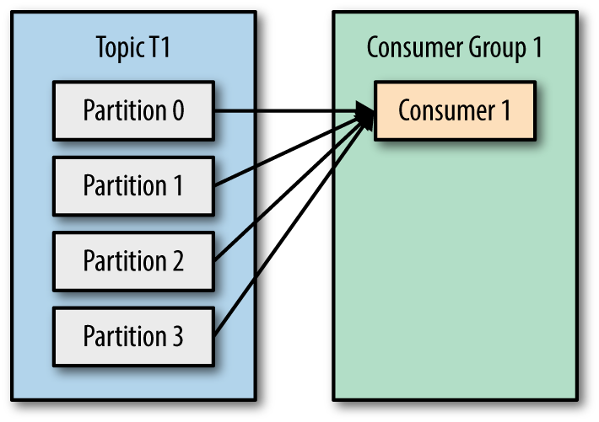
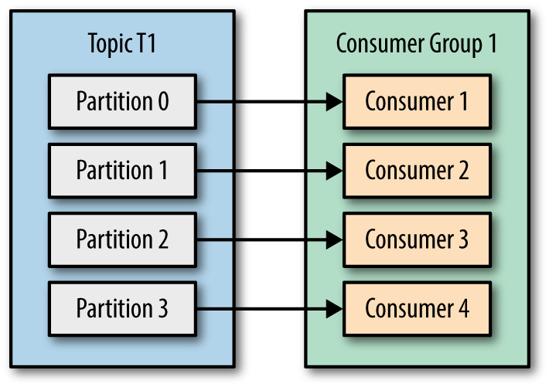
Consumer Group Scalability Example
Imagine that this consumer group “sends an e-mail.”
Each consumer in the consumer group preforms the same function
Notes:
With a single consumer, there is no scale. As data is written from producer to one of the four partitions in a round-robin fashion, the single consumer must read from all 4 partitions.
With 4 consumers in a consumer group, as data is written from producer to one of the four partitions in a round-robin fashion, each consumer can receive messages from its own partition. Allowing emails to be sent at 4x the rate.

Slide 18
Kafka Cluster Visualized

Slide 19
Kafka Cluster Visualized 1/5
This Kafka cluster has three brokers: A, B, and C.
There is a single topic “test” with a replication factor of 3 and two partitions. Lead partitions are underlined.
Broker A
Broker B
Broker C
Partition 0
Partition 0
Partition 0
Partition 1
Partition 1
Partition 1
Consumer 0
Consumer 1
Notes:
This Kafka cluster has 3 Broker A, B and C.
There is a single topic “Test” with replication factor of 3 and 2 partitions.
The lead partitions are underlined. These are assigned by the Zookeeper service which is required to run a kafka cluster.

Slide 20
Kafka Cluster Visualized 2/5
Each consumer in the consumer group for topic “test” is assigned to a partition. This is spread across brokers.
Notice in this example that Broker B is not used, as there are not enough partitions and consumers.
Broker A
Broker B
Broker C
Partition 0
Partition 0
Partition 0
Partition 1
Partition 1
Partition 1
Consumer 0
Consumer 1
Notes:
For maximum scalability, you want the number of consumers in a consumer group to match the number of partitions in a topic.

Slide 21
Kafka Cluster Visualized 3/5
When a producer writes a message to this topic, a lead partition is selected based on key, or round-robin if no key.
Topic: “Test” Message: “Foo”
Producer
Broker A
Broker B
Broker C
Partition 0
Partition 0
Partition 0
Partition 1
Partition 1
Partition 1
Consumer 0
Consumer 1

Slide 22
Kafka Cluster Visualized 4/5
In round-robin, the next message is written to the next lead partition, Partition 1 in this case.
Topic: “Test” Message: “Bar”
Producer
Broker A
Broker B
Broker C
Partition 0
Partition 0
Partition 0
Partition 1
Partition 1
Partition 1
Consumer 0
Consumer 1

Slide 23
Kafka Cluster Visualized 5/5
Should Broker A go down, for example, Zookeeper will shift the lead partition to another broker containing a replica (in this case, Broker B).
Topic: “Test” Message: “Baz”
Producer
Broker A
Broker B
Broker C
Partition 0
Partition 0
Partition 0
Partition 1
Partition 1
Partition 1
Consumer 0
Consumer 1

Slide 24
Notes:
Please copy and use this slide each time you are pausing your lecture to ask students a question. Please delete this slide if you do not need to use it.
Is any particular consumer guaranteed to receive every message in a Kafka topic for which it is subscribed?

Slide 25
Demo: Kafka Hello World
Let’s make a test topic.
Use the console to set up a producer.
Use another console to set up the consumer.
Let the data stream wash over you!
Restart the consumer from where it left off.
Restart the consumer from the beginning.
Notes:
DOCKER SETUP
.\kafka> docker-compose up –d
.\kafka> docker-compose exec broker bash
DEMO START
$ kafka-topics --zookeeper zookeeper:2181 --create --topic test --replication-factor 1 --partitions 1
TERMINAL WINDOW 1
$ kafka-console-producer --broker-list localhost:9092 --topic test
TERMINAL WINDOW 2
$ kafka-console-consumer --bootstrap-server localhost:9092 --topic test
Let the data stream flow over you!!!! Anything can be placed in the stream!
Stop the consumer and restart it you only see new messages.
$ kafka-console-consumer --bootstrap-server localhost:9092 --topic test
Stop the consumer and restart it –from-beginning gives you the old messages.
$ kafka-console-consumer --bootstrap-server localhost:9092 --topic test --from-beginning

Slide 26
Notes:
Please copy and use this slide each time you are pausing your lecture to ask students a question. Please delete this slide if you do not need to use it.
Is it possible for a consumer to see only new messages published to a topic?

Slide 27

Our Example ATM WITHDRAWLS

Slide 28
Our Example: ATM Withdrawals
Simulate live ATM withdrawals from a local bank.
Data is in JSON format—one record every 1–10 seconds.
Keys:
Location (which ATM used)
User (card holder)
Time stamp when the transaction took place
Amount of withdrawal
Status: ok/error

Slide 29
Demo: Set Up Our Example
Set up the Kafka topic “ATM withdrawals.”
Kick off the data-generator program.
Watch the stream from a console consumer.
This is great… but wouldn’t it be nice to not have to write a Java program to manipulate these data?
Notes:
PREP
.\kafka> docker-compose up –d
.\kafka> docker-compose exec broker bash
TERMINAL WINDOW BROKER
$ kafka-topics --zookeeper zookeeper:2181 --create --topic atm --replication-factor 1 --partitions 1
ANOTHER TERMINAL - START THE STREAM!!!!
.\kafka> docker-compose exec ksql-datagen bash
# cd /datasets/streaming
# ./kafka-atm-stream.sh
TERMINAL WINDOW BROKER
$kafka-console-consumer --bootstrap-server localhost:9092 –topic atm

Slide 30
KSQL Introduction

Slide 31
KSQL Introduction
It is an SQL-like, declarative stream-processing language.
It uses the Kafka streams API.
It’s an actual application that uses Kafka as its data store.
SQL-like semantics make it easier for you to build Kafka applications, just like SQL makes it easier for you to build relational applications.
KSQL is developed and maintained by Confluent.

Slide 32
Concepts
Stream: unbounded continuous flow of records, based on a topic; data sent in real time; records are key-value pairs; we want to process the records as they arrive
Consumes data from a Kafka topic and writes the manipulations to another Kafka topic
Kafka Topic “IN”
KSQL
Kafka Topic “OUT”

Slide 33
Demo: Streams in KSQL
Let’s create a KSQL stream
CREATE STREAM statement to make the stream
SELECT statement to query it
What’s going on here? Stopping the program
Using limit to end the query
Notes:
View schema of ATM again in the consumer
KSQL> CREATE STREAM USERS (user varchar) with (kafka_topic='atm', value_format='json’);
# Explain this statement!!!
# RUN A PROGRAM USING THIS STREAM
KSQL> select * from USERS;
# Discuss what is seen in the output. But don’t explain it all at this time!
# This is a non-persistent query. Press CTRL + C to break
KSQL> select * from USERS limit 3;
# You only get 3

Slide 34
Notes:
Please copy and use this slide each time you are pausing your lecture to ask students a question. Please delete this slide if you do not need to use it.

Slide 35

KSQL: Creating Stream

Slide 36
Basic Commands
SHOW TOPICS;
SHOW STREAMS;
CREATE STREAM;
DESCRIBE;
DROP STREAM;

Slide 37
Create Stream
Like the create table statement but makes Kafka streams
CREATE STREAM stream_name ( { column_name data_type } [, ...] ) WITH ( property_name = expression [, ...] );
Example:
CREATE STREAM atm_amounts ( user VARCHAR, amount DOUBLE ) WITH ( KAFKA_TOPIC='users', VALUE_FORMAT='JSON');

Slide 38
KSQL Data Types and Properties
Data Types
Properties
BOOLEAN
INTEGER (4 Bytes)
BIGINT (8 Bytes)
DOUBLE
VARCHAR (or STRING)
KAFKA_TOPIC
VALUE_FORMAT (JSON | DELIMITED)
TIMESTAMP
KEY

Slide 39
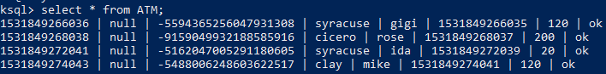
ROWTIME and ROWKEY
Every stream has these two values, implicitly:
ROWTIME: associates the message time stamp in Kafka topic with a field in the KSQL stream; can be set with the TIMESTAMP property—if not, uses a time stamp of when the message arrived
ROWKEY: associates the message key in a Kafka topic with the field in the KSQL stream; null when no key is set in the topic

Slide 40
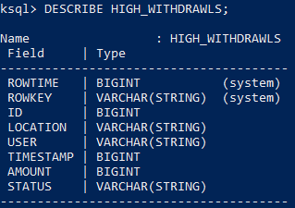
Describe
Used to view the schema of a stream (or table)
DESCRIBE stream_name;

Slide 41
Demo: Creating Streams
Create ATM stream in KSQL
Create another stream without TIMESTAMP property.
Inspect topics.
Inspect streams.
Describe a stream.
Delete a stream.
Notes:
View schema of ATM again in the consumer
KSQL> CREATE STREAM ATM (id bigint, location varchar, user varchar, timestamp bigint, amount double, status varchar) with (kafka_topic='atm', value_format='json’, timestamp=‘timestamp’);
# Explain this statement!!!
# RUN A PROGRAM USING THIS STREAM
KSQL> select * from ATM;
# Now make another stream which does not use the time stamp.
KSQL> CREATE STREAM ATM2 (id bigint, location varchar, user varchar, timestamp bigint, amount double, status varchar) with (kafka_topic='atm', value_format='json’);
KSQL> select * from ATM2;
# Notice the stream has different timestamps. The data timestamp and the ROWTIME are now different.
KSQL> SHOW TOPICS;
KSQL> SHOW STREAMS;
KSQL> DELETE STREAM ATM2;

Slide 42
Notes:
Please copy and use this slide each time you are pausing your lecture to ask students a question. Please delete this slide if you do not need to use it.
Explain the purpose of the timestamp property in the create stream statement? What data type must it be?
It associates a column in the stream with the ROWTIME internal property of the stream. BIGINT

Slide 43
KSQL Persistent Queries

Slide 44
Persistent Queries
The queries we’ve run so far execute in the KSQL console. What if we want to run them in the background?
CREATE STREAM stream_name AS SELECT …
It creates a new Kafka topic with the same stream name.
It runs in the background!

Slide 45
What Is Running?
SHOW QUERIES;
This will list the running persistent queries.
It includes the KSQL query itself and the Kafka topic.
You can stop running a persistent query with TERMINATE.
TERMINATE query_name;
After you terminate, you can drop the stream.

Slide 46
Demo: KSQL Persistent Streams
Write a query.
Make it persistent.
Show the topic, query, and stream.
Try to drop the stream—you can’t.
Terminate the query, then drop it.
Notes:
ksql> select * from ATM where location='syracuse’;
# How do we save this so that it runs in the background?
ksql> create stream syracuse_activity as select * from ATM where location='syracuse’;
# Says stream created and running… Wha?
ksql> select * from syracuse_activity;
Ksql> show streams;
# notice it’s a kafka topic
Ksql> show topics;
Ksql> show queries;
# Try to terminate
Ksql> drop stream Syracuse_activity;
# you cannot drop…..
Ksql> terminate query <name>
Ksql> drop query Syracuse_activity;

Slide 47
Notes:
Please copy and use this slide each time you are pausing your lecture to ask students a question. Please delete this slide if you do not need to use it.
Why can’t you simply drop a stream?
Because its running in the background. You need to terminate the running query before you drop it.

Slide 48
Demo: Aggregate Queries
How aggregate queries work in KSQL is best explained through an example:
Let’s count ATM withdrawals.
Must group by a key! Why?
Why can’t I persist this query?
Notes:
ksql> select count(*) from ATM
# Needs group by --- why? It’s impossible for a steam of data to provide a total. The data is continuous, so it cannot produce a grand total.
ksql> select location, count(*) as transaction_count from ATM group by location;
# we see output, but what are actually seeing here?
# After more data goes by it should be more more apparent, we are seeing a new row for each message in the stream,
# but the output is a running count from the beginning of the query!
# maybe you want to persist this:
ksql> create stream counts_by_location as select location, count(*) as transaction_count from ATM group by location;
# Invalid result type your SELECT produces a table? Huh?

Slide 49
KSQL Tables vs. Streams

Slide 50
Tables vs. Streams
Stream
Table
An unbounded sequence of events
Sourced from a Kafka topic
Row by row
Example: bank transactions
A materialized view of events with only the latest value for each key
Aggregate or summary
Example: account balances
If it summarizes/aggregates a stream, it’s a KSQL table!

Slide 51
Demo: Persistent Tables
Let’s persist the count of withdrawals query as a table.
Show tables;
Show queries;

Slide 52
Notes:
Please copy and use this slide each time you are pausing your lecture to ask students a question. Please delete this slide if you do not need to use it.

Slide 53

KSQL SELECT Statement

Slide 54
KSQL SELECT
Syntax similar to a Relational SQL SELECT, with some twists
SELECT select_expr [, ...]
FROM from_item
[ WINDOW window_expression ]
[ WHERE condition ]
[ GROUP BY grouping_expression ]
[ HAVING having_expression ]
[ LIMIT n ];
Notes:
Not

Slide 55
Scalar Functions
Function | Example | Description
CONCAT | CONCAT(col1, '_hello') | Concatenate two strings
EXTRACTJSONFIELD | EXTRACTJSONFIELD (message, '$.log.cloud') | Given a string column in JSON format, extract the field that matches
LEN | LEN(col1) | The length of a string
STRINGTOTIMESTAMP | STRINGTOTIMESTAMP(col1, 'yyyy-MM-dd HH:mm:ss.SSS') | Converts a string value in the given format into the BIGINT value representing the time stamp
SUBSTRING | SUBSTRING(col1, 2, 5) | Return the substring with the start and end indexes
TIMESTAMPTOSTRING | TIMESTAMPTOSTRING(ROWTIME, 'yyyy-MM-dd HH:mm:ss.SSS') | Converts a BIGINT timestamp value into the string representation of the timestamp in the given format
TRIM | TRIM(col1) | Trim the spaces from the beginning and end of a string
https://docs.confluent.io/current/ksql/docs/syntax-reference.html#scalar-functions

Slide 56
Cast
Works just like the SQL server cast.
CAST(col as TYPE)
SELECT cast(amount as varchar) FROM ATM;

Slide 57
Like
Suffix matching, similar to relational SQL
SELECT user_id
FROM users
WHERE user_id LIKE 'santa%';

Slide 58
Demo: KSQL Functions
User and location as a single column
Show the minute of the transaction
Transactions in the last 30 seconds of each minute
Notes:
# user and location as a single column
Ksql> select concat(user,concat('-', location)) from atm2;
# show the minute of the transaction
Ksql> select timestamptostring(timestamp, ‘mm’) from atm;
# separate out the time
Ksql> select timestamptostring(timestamp, ;hh:mm:ss’) from atm;
# or we can use rowtime !!!
Ksql> select timestamptostring(rowtime, ‘mm’)
# Transactions in the last 30 seconds of each minute
Select user, location, amount, timestamptostring(rowtime, ‘yyyy-MM-dd hh:mm:ss’) where cast( timestamptostring(timestamp,'ss') as BIGINT) > 30

Slide 59
Windows in KSQL

Slide 60
Windowing
Since streams are unbounded, you need a time window for aggregations.
Example: count web page views for today
Windowing allows us to do just that group streams of data by time into buckets, rather than aggregate from the beginning of query execution.
These buckets provide a way to get concrete results from a continuous stream of data.
They must be windowed by a key in the GROUP BY clause.

Slide 61
Windowing Options
When grouping, KSQL provides three different windowing functions:
Tumbling: fixed size, non-overlapping; the SIZE of the window needs to be specified
Hopping: fixed size, possibly overlapping.; the SIZE and ADVANCE parameters need to be specified
Session: fixed size, starting from the first entry for a particular key; it remains active until a new message with the same key happens within the INACTIVITY_GAP, which is the parameter to be specified; useful for detecting anomalies

Slide 62
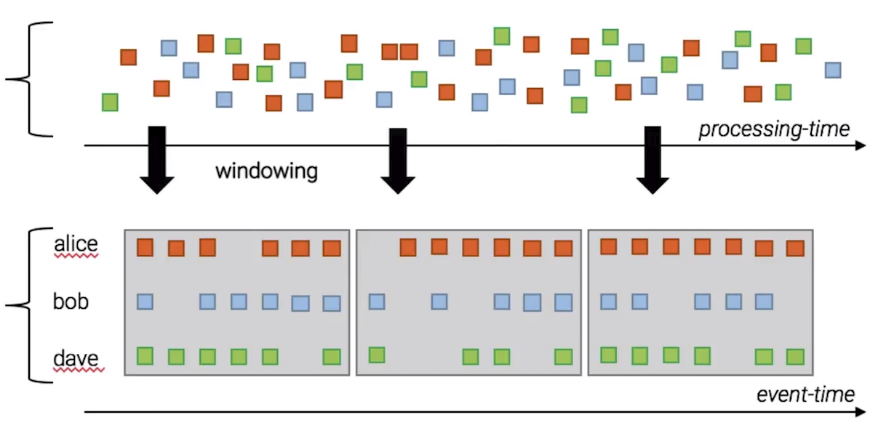
Example: Tumbling Window
Information is still reported as it arrives; aggregate is reset when the window moves.

Slide 63
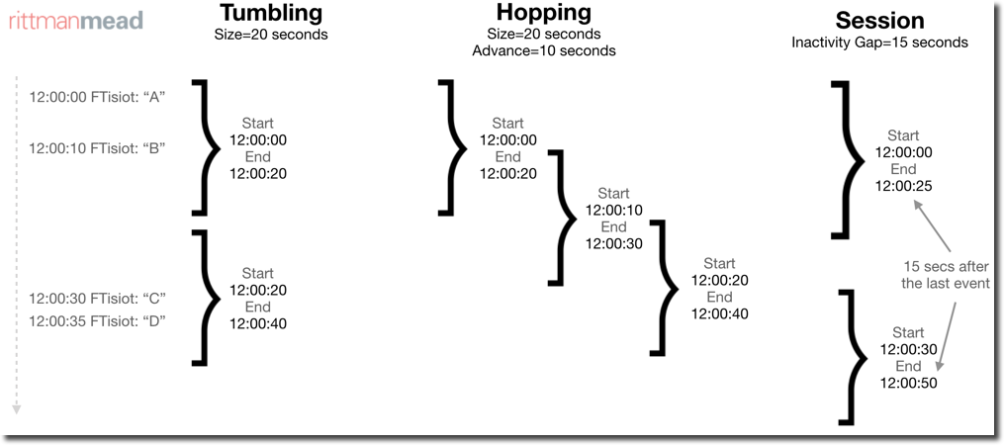
Windowing
Tumbling Size=20 seconds
Hopping Size=20 seconds Advance=10 seconds
Session Inactivity Gap=15 seconds
12:00:00 FTisiot: “A”
Start 12:00:00 End 12:00:20
Start 12:00:00 End 12:00:20
Start 12:00:00 End 12:00:25
12:00:10 FTisiot: “B”
Start 12:00:10 End 12:00:30
Start 12:00:20 End 12:00:40
Start 12:00:20 End 12:00:40
15 secs after the last event
12:00:30 FTisiot: “C”
12:00:35 FTisiot: “D”
Start 12:00:30 End 12:00:50

Slide 64
Notes:
Please copy and use this slide each time you are pausing your lecture to ask students a question. Please delete this slide if you do not need to use it.

Slide 65
Demo: Windowing
Tumbling window
Hopping window
Session window
Notes:
# tumbling window – total user withdrawals each hour (make it a minute to see it reset)
select user, sum(amount) as total_amount, count(*) as transaction_count from atm window tumbling (size 30 seconds) group by user;
# Hopping window – count activity by location every 15 seconds in 30 second windows
ksql> select location, count(*) from atm window hopping (size 30 seconds, advance by 15 seconds ) group by location;
# session – anomaly detection. More than 2 errors in a 4 hour window at any location.
ksql> select location, count(*) as error_count from atm window session (4 hours) where status='ok' group by location having count(*) > 2;

Slide 66

Use Cases for Kafka Streams KSQL

Slide 67
Use Cases for Kafka Streams
ETL as a stream
Anomaly detection
Real-time monitoring

Slide 68
ETL: Extract-Transform-Load
These tools are designed to move data from system to system, manipulating the data from the source to fit the needs of the target.
Traditional ETL is a batch process that must be “kicked off” at a given point in time.
Manipulations occur over often large sets of records, but less frequently.
The Kafka way is to process the data as they arrive in real time.
Manipulations occur one record at a time, and more frequently.

Slide 69
Streaming ETL
They transform data as they arrive and store the transformation somewhere else.
Apache Kafka is a popular choice for powering data pipelines. KSQL makes it simple to transform data within the pipeline, readying messages to cleanly land in another system.
Topic in, topic out.
create stream high_withdrawls as select * from ATM where amount >=160;

Slide 70
Anomaly Detection
KSQL is a good fit for identifying patterns or anomalies on real-time data. By processing the stream as data arrive, you can identify and properly surface out of the ordinary events with millisecond latency.
Example: More than one error within four hours of each other? ATM is out of money!
create table out_of_money as select location, count(*) from ATM window session (4 hours) where status=‘error’ group by location having count(*) > 1;

Slide 71
Real-Time Monitoring
Kafka’s ability to provide scalable ordered messages with stream processing makes it a common solution for log data monitoring and alerting. KSQL lends a familiar syntax for tracking, understanding, and managing alerts.
Example: What’s happening at the Syracuse ATM?
create stream syracuse_activity as
select * from ATM where location = 'syracuse';

